Slide 1

Name: Aqil Reid Title: Data Science Intern Location: Jamaica

Slide 2
R
Reinforcement
Learning

Slide 3

What is Reinforcement Learning?
Reinforcement Learning is a type of machine learning where...

Slide 4

Components of Reinforcement Learning
Reinforcement Learning involves three main components:
1. Agent:
2. Environment
3. Actions and States

Slide 5

Application to a Snake Game
Pygame was used to create the environment.
An agent was created and connected to the environment.
Left, right and do nothing were specified as actions the agent can take.
A deep learning model (Deep Q Network) was created using pytorch.

Slide 6
Model Based Vs Model Free RL
Model Based: Learn from a prior already understood model of the environment.
Model Free: No prior understanding of what behaviour should be like in a specific environment.

Slide 7
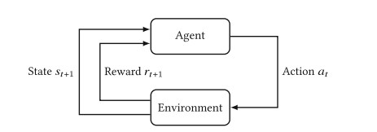
Focusing On the Model Based RL Approach
I will show policy optimization through two approaches; MDP and Deep Learning.

Slide 8

Important Concepts for Clearer Understanding
Markov Dynamics Model
Reward Model
Policy
Value
State Action Value
Temporal Difference

Slide 9
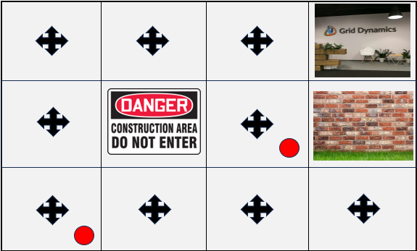
Markov Model(Reduced State Space Illustrative Example)
P(s_{t+1} = s’|s_{t} = s, a_{t} = a)
{No history needed, hence Markov}

Slide 10
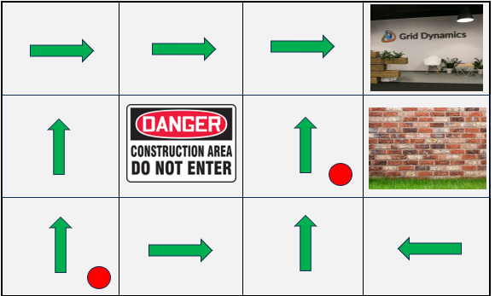
For Simplicity We Make The Transition Probability Equal To 1.
P(s_{t+1} = s’|s_{t} = s, a_{t} = a) = 1
{This is a plan/single deterministic policy}

Slide 11
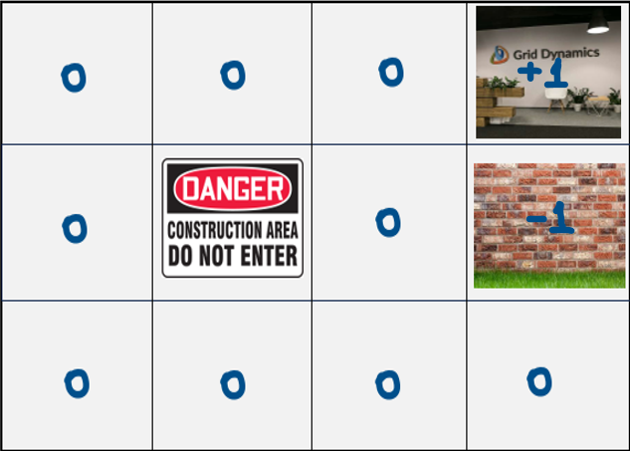
Reward Model
r(s_{t} = s, a_{t} = a) = E[r_{t} |s_{t} = s, a_{t} = a]

Slide 12
Policy
The policy is what tells the agent how to behave in each state.
π(s) = a
{Deterministic, only 1 action can be taken}.
π(a|s) = Pr(a_{t} = a|s_{t} = s)
{Stochastic, multiple possible actions}

Slide 13
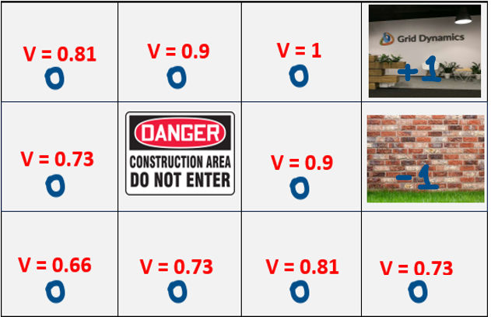
Value Of A State
V(s) is calculated for each state.
V_{t} = r_{t+1} + γr_{t+2} + γ² r_{t+3} + · · ·
{γ is the discount rate}.
V(s) = E[G_{t} |s_{t} = s] = E[r_{t+1} + γr_{t+2} + γ² r_{t+3} + · · ·|s_{t} = s]
{This is more commonly expressed using the in the Bellman Eq form}.

Slide 14
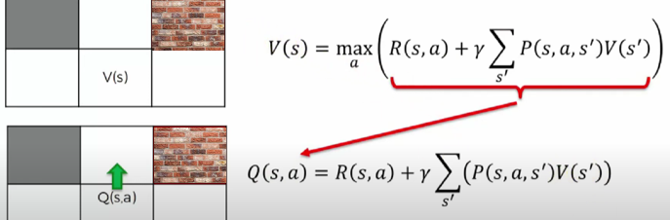
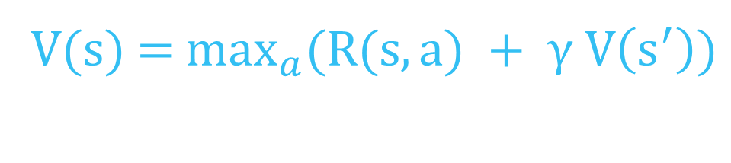
Building Out Bellman’s Equation
V(s) = $\max_{a}(R(s,a) + γ V\left(s^{′}\right))$

Slide 15

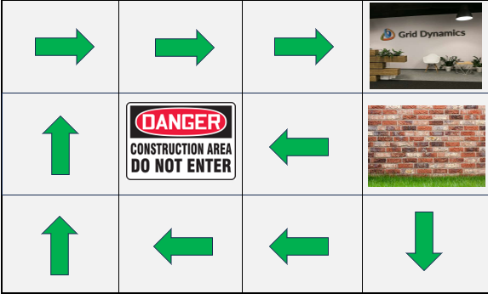
Using The Updated Function For V(S)
The values have now updated to reflect the stochasticity of the system.
The optimal plan/policy has now been updated.

Slide 16
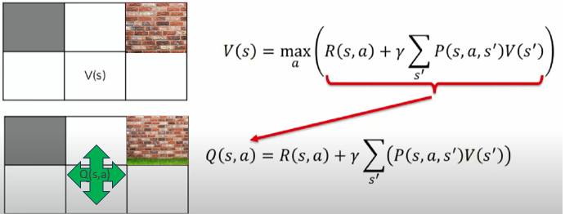
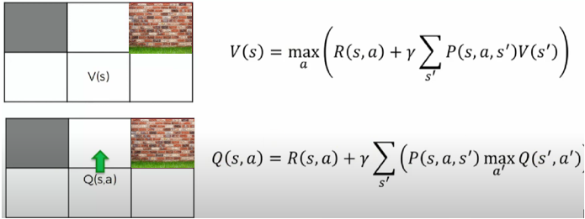
State Action Value and Bellman’s Equation
Multiple substitutions to produce the final form of the equation.

Slide 17
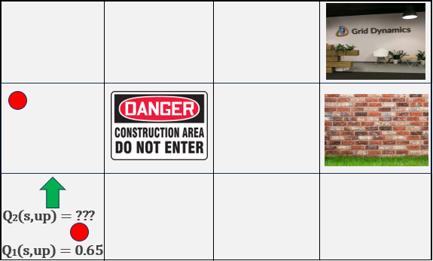
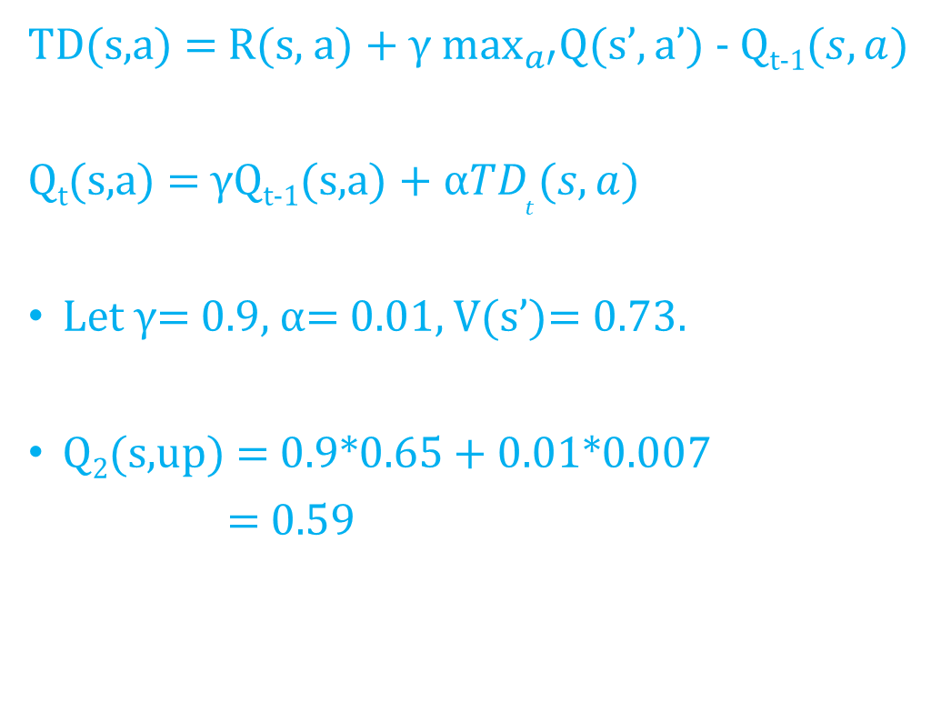
Temporal Difference and The Transition Into Deep-Q Learning
TD(s,a) = R(s, a) + $γ\max_{a′}Q(s’,a’)$ - Q_{t-1}$(s,a)$
Q_{t}(s,a) = γQ_{t-1}(s,a) + $α{TD}_{t}(s,a)$
Let $γ$= 0.9, $α$= 0.01, V(s’)= 0.73.
Q₂(s,up) = 0.9*0.65 + 0.01*0.007
= 0.59

Slide 18
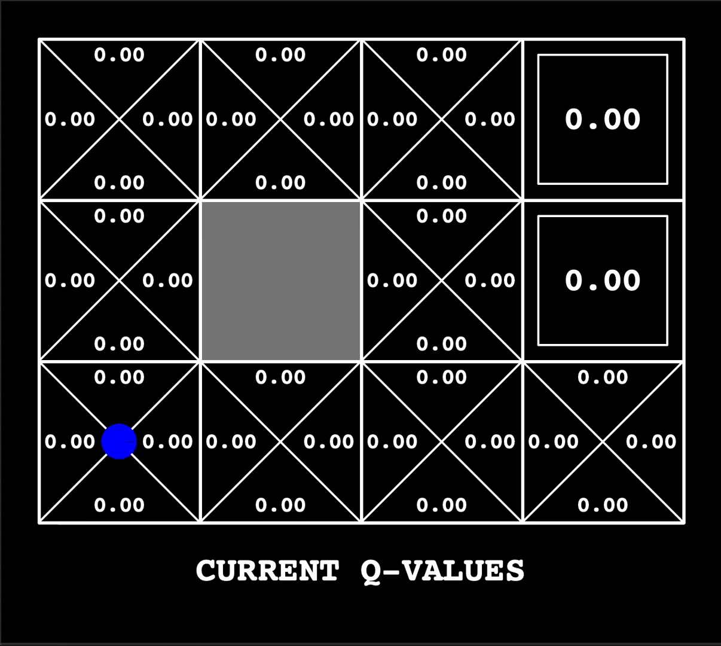
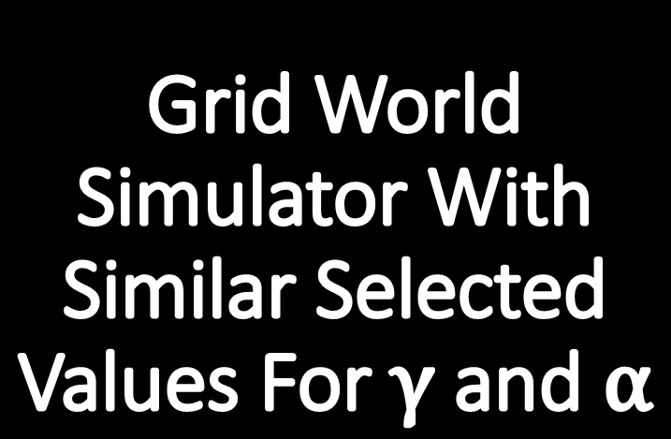
Grid World Simulator With Similar Selected Values For $γ$ and $α$

Slide 19
Deep-Q Learning(Model Free)
Even though previous methods work well and utilize foundation principles, things get more complicated when the environment is the real world or even a game like Atari or Mario Cart.

Slide 20
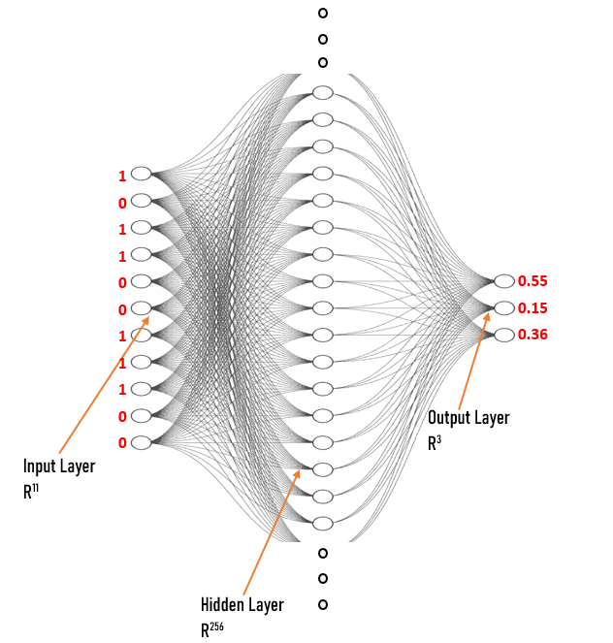
Architecture of The DQN For The Snake Game
A simple feed forward neural network is used to predict the Q(s,a) values for each state.
The state of the environment is fed to the neural network as a tuple of length 11.

Slide 21
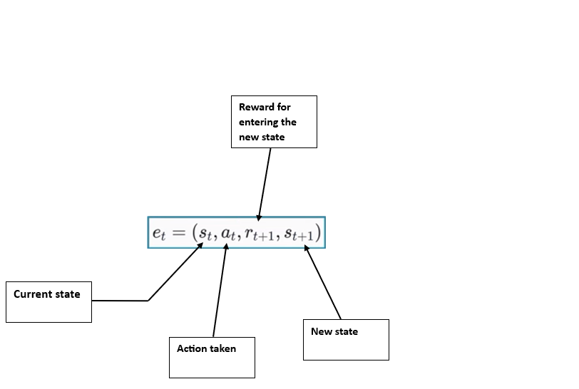
All the agent’s experience over every timestep over every episode is saved to a file called replay memory.
This is randomly and uniformly sampled to train the network.

Slide 22
Replay Memory
$$\left(s_{1}, a_{1},r_{2},s_{2}\right), 1$$
$$\left(s_{2}, a_{2},r_{3},s_{3}\right), 2$$
$$\left(s_{3}, a_{3},r_{4},s_{4}\right), 3$$
$$\left(s_{t}, a_{t},r_{t+1},s_{t+1}\right), P$$

Slide 23
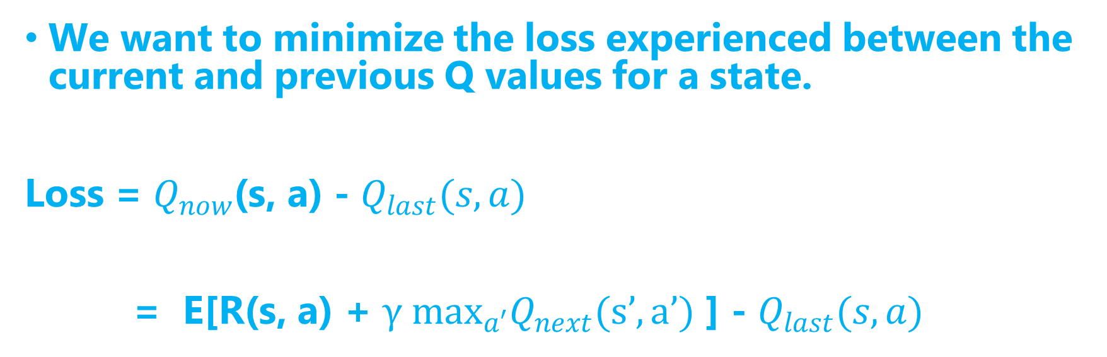
Objective
We want to minimize the loss experienced between the current and previous Q values for a state.
Loss = $Q_{now}$(s, a) - $Q_{last}(s,a)$
= E[R(s, a) + $γ\max_{a′}Q_{next}(s’,a’)$ ] - $Q_{last}(s,a)$

Slide 24
Method/Algorithm
Initialize replay memory D to capacity P
Initialize action-value function Q with random weights ɵ
Initialize target action-value function Ǭ with random weights ɵ⁻ = ɵ
For episode = 1 to M do
Initialize sequences e₁ = {s₁}
For t = 1 to T do
With probability ɛ select a random action a_{t}

Slide 25
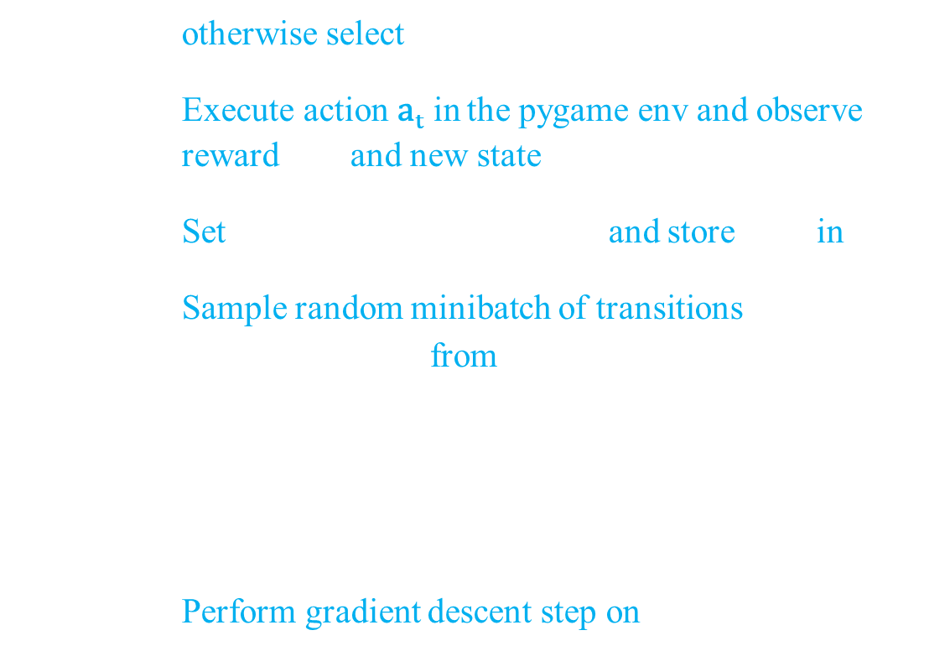
Continuing….
otherwise select $a_{t}={argmax}_{a}Q(s_{1}, a; ɵ)$
Execute action a_{t} in the pygame env and observe reward r_{t +1} and new state $s_{t+1}$
Set $e_{t+1}=(s_{t}, r_{t+1},a_{t}, s_{t+1})$ and store $e_{t+1}$ in D
Sample random minibatch of transitions $(s_{j}, r_{j+1},a_{j}, s_{j+1})$ from D
Set $y_{j}= \left\{\begin{aligned}r_{j+1} \\ Or \\ {r_{j+1}+max}_{a^{′}}Q(s_{j+1}, a′; ɵ)\end{aligned}\right\}$
Perform gradient descent step on ${{(y}_{j}− Q(s_{j}, a_{j}; ɵ))}^{2}$

Slide 26
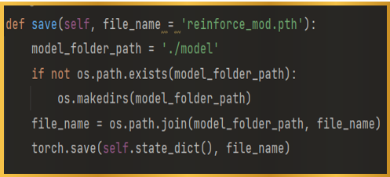
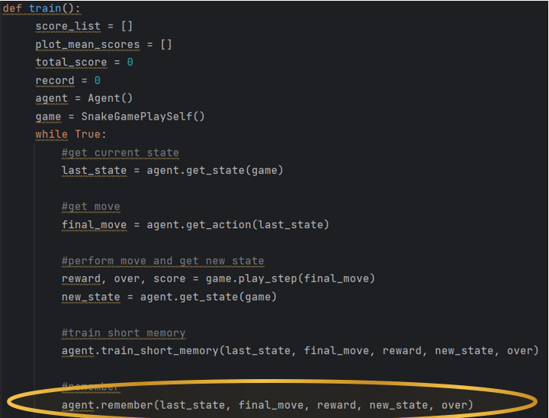
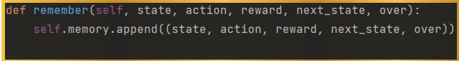
Store the experience tuple

Slide 27
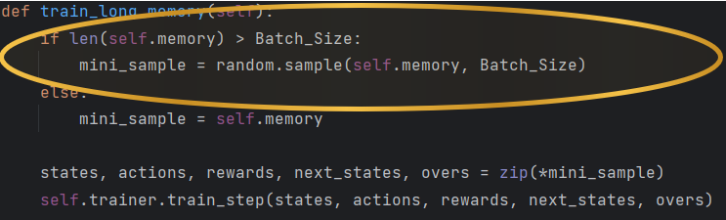
Sample the random batch from replay memory

Slide 28
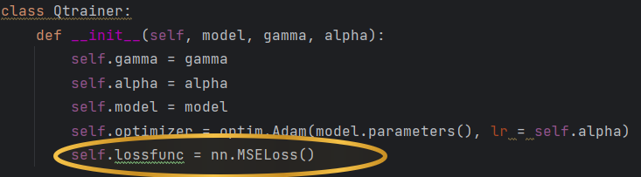
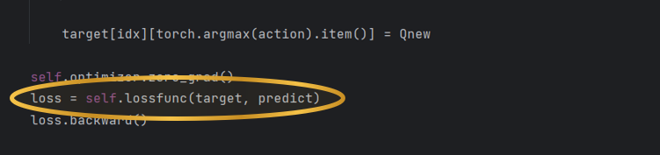
Calculate the loss between output Q-values and target Q-Values

Slide 29
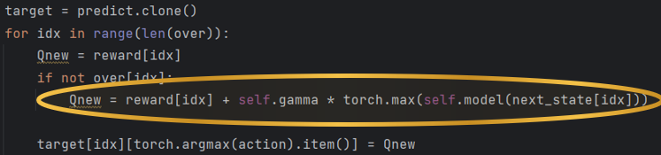
Pass the next state to the network afterwards.

Slide 30
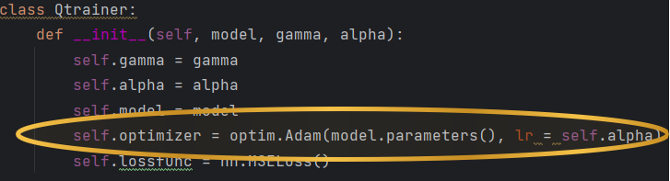
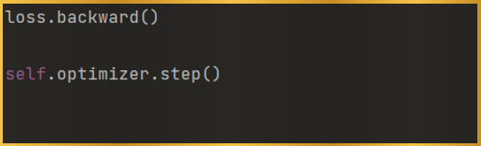
Gradient descent and back propagation updates weights in the policy network to minimize loss.

Slide 31
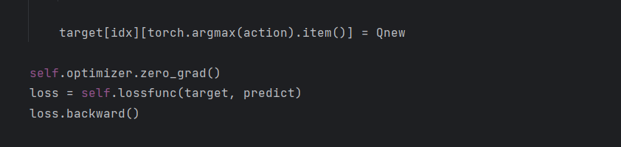
Derivative Of The Loss Function
$$ɵ_{t+1}=ɵ_{t}+ α{[r_{t+1}+γ max}_{a^{′}}Q\left(s_{t+1}, a′,ɵ_{t}\right)−Ǭ\left(s_{t},{ a}_{t},ɵ_{t}\right)] ∇Ǭ\left(s_{t},{ a}_{t},ɵ_{t}\right)$$

Slide 32
Other Applications of Reinforcement Learning
F
Finance and Trading
Robotics
R
H
Health Care
Energy Management
E
A
Advertising and Marketing

